Slide 1
Lab 12: Climate
Hannah Daley
Adapted from Justin Hicks

Slide 2
Lab updates:
You will need a scientific calculator for lab this week. If you do not have one, use an online calculator (SHARING OF CALCULATORS WILL NOT BE ALLOWED)
Next week will spend sometime outside
No Final in AOSC201
No Extra Credit or curves (please see AOSC201 syllabus with any questions)
I will drop your lowest grade or your first missed lab. This has already been applied to your grade in ELMS.

Slide 3
Stefan-Boltzmann Law
#1+2
E = σAT⁴
Relates the energy given off by an object to the temperature of the object
E = energy, σ = Boltzmann constant, A = area (in the case of this lab, the area of Earth), T = temperature
We can substitute the amount of solar energy striking earth for energy (E)
SπR_{e}² = σAT⁴
Where S is the solar constant (what is emitted by the sun) and R_{e} is the radius of the Earth

Slide 4
Albedo
#3
An object’s albedo is equivalent to the amount of sunlight it reflects (as a percentage of total sunlight it interacts with)
Objects with high albedo (~1) reflect a lot of solar radiation
Objects with low albedos (~0) absorb a lot of solar radiation
A planet’s albedo can affect its temperature
Just because a planet is close to the sun doesn’t mean it is hot → it could have a large albedo and instead heats up due to a thick, greenhouse gas-laden atmosphere
If albedo = α, then the absorption of an object is equal to 1-α

Slide 5
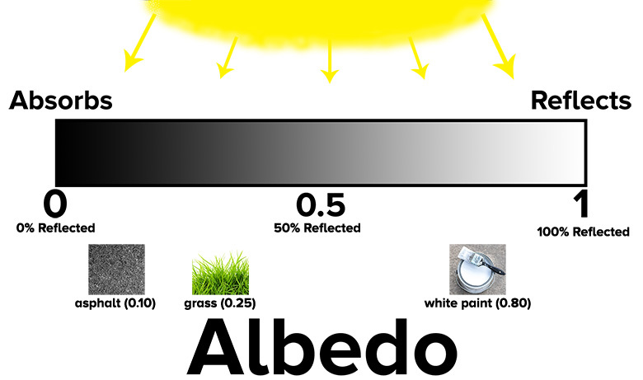

Slide 6
Effective Temperature
#3
We can find the temperature we’d expect a planet to have (assuming it has no atmosphere) by taking into account its albedo → this temperature is called the effective temperature
We can find this temperature by rearranging the Stefan-Boltzmann law (#2) and using the surface-absorbed radiation in place of S, the solar constant
Hint: S is the solar radiation that makes it to earth, but we want to find the amount of solar radiation that is absorbed by the earth
Must take albedo into account

Slide 7
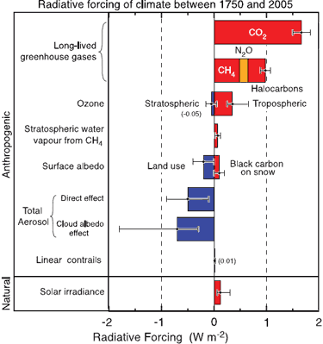
Greenhouse Gases
#5-11
A planet’s temperature is factored by distance from the sun, albedo, thickness of atmosphere, composition of atmosphere (GHG)
Greenhouse gases absorb infrared radiation, warming the atmosphere
Common greenhouse gases: carbon dioxide, nitrous oxide, trop. ozone, CFCs and HFCs, methane, etc
We can compute how much radiation these gases absorb (radiative forcing), as well as their effect on average global temperatures

Slide 8
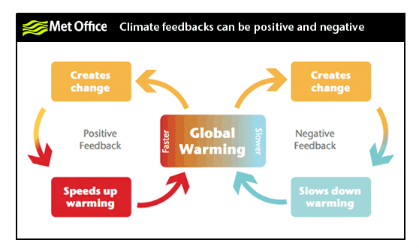
Climate feedbacks
#12-15
Change in the climate which has an effect that then causes further climatic change
Ex: ice-albedo feedback
Increasing temperatures increases the rate at which ice melts → exposes more ocean water (albedo decreases) → oceans warm → more ice melts
Need to account for these feedbacks in order to determine how much GHG have actually raised global temperatures

Slide 9
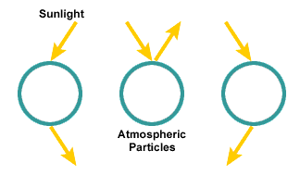
Aerosols

Slide 10
Aerosols
#15-16
Aerosols are solids or liquids suspended in the atmosphere
Can be natural (sea spray) or anthropogenic (soot)
Aerosols reflect and scatter incoming solar radiation
Typically have a cooling effect on the surface (except for black carbon, which absorbs solar radiation)
Must account for feedbacks AND aerosols when determining how much anthropogenic activity has increased global temperatures
As we clean our air and decrease the amount of aerosols in the atmosphere, we may lose the cooling effect that aerosols provide (this is why research is important and proactivity is required)

